Slide 1
IT2311- Rapid Application Development
Week 10 & 11-Visual Basic: ADO. Net Introduction

Slide 2
Introduction
Data is generally stored in a relational database in the form of related Tables.
Retrieving & Manipulating data directly from a database requires the knowledge of database commands to access the data.
Eg. SQL Server database may not be convenient for a person who does not know SQL statements.

Slide 3
Business Application
Business application allows users to retrieve the data stored in a database & present it in user friendly interface.
Without having to write database command.
User can even add, delete ,update database record directly from application

Slide 4
Applications Needs to …
Retrieving the data stored in the database & presenting it in a user friendly.
Updating the database
ADO.NET is a modal used by .NET application to communicate with the database for retrieving & updating Data.

Slide 5
Features of ADO.NET
Disconnected Data Architecture
Application connect to the database only while retrieving & updating data
After the data retrieved, the connection with the data is closed
If we want ,Connection is reestablished
Reduce the wastage of valuable system recourses

Slide 6
Features of ADO.NET
Data cached in datasets
Dataset is the most common method of accessing data in ADO.NET
ADO.NET based on disconnected architecture, it is not possible for application to interact with the database for processing each record
So the data is retrieved and stored in datasets

Slide 7
Dataset
A dataset is a cached set of database records.
Can work with the records stored in a dataset as real data.
Only, difference is, dataset is independent of data source.

Slide 8
Features of ADO.NET
ADO.NET supports scalability by working with dataset
Dataset operations are performed on dataset instead of on the database
As a result, recourses are saved & the database can meet increasing demands of users more efficiently.

Slide 9
Features of ADO.NET
Data transfer in XML format
XML is the fundamental format for data transfer in ADO.NET
Data is transferred from a database in to a dataset and from dataset to another component by using XML
Can use an XML file as a data source & store data from it in a dataset

Slide 10
Features of ADO.NET
Interaction with the database is done through data commands
A data command object can be used for accessing or updating the data using either a SQL statement or a stored procedure
Can retrieve insert ,delete or modify data from a database by executing data commands

Slide 11
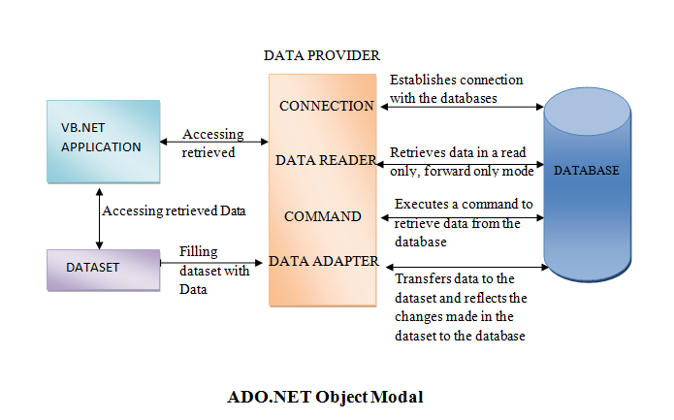
ADO.NET object Modal

Slide 12
ADO .NET
The data residing in a database is retrieved through data provider
An application can access either through a dataset or data Reader objects

Slide 13
Using dataset
Data is cached in a dataset and the application access the data from dataset

Slide 14
Using data reader
is component of a data provider
Uses connection object to connect to the database
uses the command object to retrieve data
provides data to the application in a read only & forward only mode

Slide 15
Data Provider
Data provider is used for
Connecting to database
Retrieving data
Storing the data in a dataset
Reading the retrieved data and updating database

Slide 16
Data Provider Cont
Two types of data provider
OLEDB data provider
Works with all OLEDB providers such as SQL OLEDB,JET OLEDB , Oracle OLEDB
OLEDB data provider classes are present in the System,Data.Oledb namespace
SQL Server data provider
Used to work with specifically with Microsoft SQL server
SQL server data provider allow fast access to data source
SQL server data provider classes are present in the System,Data.Sqlclient namespace

Slide 17
Components in Data Provider
Connection
Data Adapter
Data Command
Data Reader

Slide 18
1. Connection
Used to established a connection with a data source
Two of the most common connection objects
OleDbconnection
SqlConnection

Slide 19
1. Connection cont
Properties & Methods of a connection objects
ConnectionString property
Provide information such as the data source database name
That is used to established connection with a database
Open() method
Use to open a connection with the data source that is specified in the ConnectionString property
Close () method
Use to close the connection with a data source
State property()
Use to describe the current state of the connection object
0-the connection is closed
1-the connection is open

Slide 20
2. Data Adapter
A data adapter is integral to the working of ADO.NET
Data is transferred to and from a database through a data adapter
It retrieves data from a database into a dataset
When you make changes to the dataset, the changes in the database are actually done by the data adapter
Data adapter first compare the data in the dataset with that in the database and then updates the database
You access data from a database by configuring a data adapter

Slide 21
2. Data Adapter cont
Two data adapters in VB.NET
Sql Data Adapter
Configure to access data specifically from Microsoft SQL Server
OleDbDataAdapter
Configure to access data from any database that is supported by an OLEDB data provider

Slide 22
2. Data Adapter cont
A data adapter uses connection objects provided by the data provider to communicate with the database
OleDbConnection
SqlConnection
Data Adapter handles data transfer between the database & the dataset through it properties and method & display the data through the process of mapping
Data adapter properties and method
A data adapter communicates with a database while retrieving ,inserting, deleting and updating data

Slide 23
Data adapter properties and method
To perform various operation on database
SelectCommand
Refers to a SQL statement or stored procedure to retrieve data from the database
InsertCommand
Data command to insert data into database
UpdateCommand
Data command to update data into database
DeleteCommand
Data command to delete data into database
Fill() method
Fills the dataset with a records from a database
Update() method
Execute to corresponding insertcommand , updatecommand or deletecommand

Slide 24
Creating Data Adapter
Three methods
Through Wizard
Using Server Explorer
Programmatically

Slide 25
3. Data command
A data command is an object representing a SQL statement or a stored procedure that is used to retrieve, insert, delete, modify data in a data source
A data command is an object of the OleDbCommand or SQLCommand class
For retrieving data through data commands, a connection object is created first to connect the database from where the data is to be retrieved.

Slide 26
Data command cont.
Then the command object is created that refers SQL statements or procedure that is executed
To access a data source , a data command should provide information about the connection for communicating with a data source
Parameters that may be required for execution of the data command

Slide 27
Data command cont.
'Create a connection
Dim cn As New SqlConnection("server=JEECOM\SQLEXPRESS;database=CustomerDB;Integrated Security=SSPI")
cn.Open()
Dim cmsql As SqlCommand=New SqlCommand ( "DELETE from cus where cusemp=" & Val(TextBox3.Text),cn)
cmsql.ExecuteNonQuery()

Slide 28
Data command cont.
'Create a connection
Dim cn As New SqlConnection("server=JEECOM\SQLEXPRESS;database=CustomerDB;Integrated Security=SSPI")
cn.Open()
Dim cmsql As New SqlCommand
cmsql.Connection = cn
cmsql.CommandText = "DELETE from cus where cusemp=" & Val(TextBox3.Text)
cmsql.ExecuteNonQuery()

Slide 29
4. Data Reader
Data reader is used to retrieve data from a data source in read only and forward only mode
A data reader uses connection object to connect the database
The command object to execute SQL statements or procedures on the database and retrieves the data in sequential mode
Using data reader results in faster access to data and less memory usage since at any time
Only a single row is stored in the memory

Slide 30
Data Reader cont.
Imports System.Data.SqlClient
Public Class Form1
Private Sub Button1_Click(ByVal sender As System.Object, ByVal e As System.EventArgs) Handles Button1.Click
Dim cn As New SqlConnection("server=JEECOM\SQLEXPRESS;database=Northwind;Integrated Security=SSPI")
' Create a SqlDataReader object
Dim dr As SqlDataReader
' Create a new SqlCommand object
Dim cmd As New SqlCommand()
' Set the Select statement in the CommandText property and
' set the Connection property to the "cn" SqlConnection object
' you just created

Slide 31
Data Reader cont.
With cmd
.CommandText = "Select CustomerID, CompanyName,ContactName from Customers"
.Connection = cn
End With
' Open the Connection
cn.Open()
' Call the ExecuteReader method of the Command object
dr = cmd.ExecuteReader(CommandBehavior.CloseConnection)
' Call the Read method of the DataReader to loop thru the records
While dr.Read
' Add the items to the ListBox1 control
ListBox1.Items.Add(dr("CustomerID") & ", " & dr("CompanyName"))
End While
' Close the connection
cn.Close()
End Sub
End Class

Slide 32
Reference
http://www.cis.usouthal.edu,2014/04/18

